Slide 1
Data Security of IoT-based smart health care
Presented By: Divyansh Nigam Md Rashedur Rahman Graduate student, GMU

Slide 2
Outline
Introduction
Proposed Architecture
Future Work
Conclusion and Demo

Slide 3
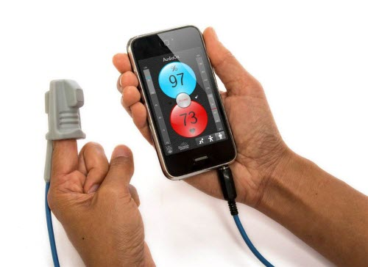
Introduction-Background
Patient Care Application
Monitoring the patient status
Required for critical patients
Alzheimer, Cancer, Chronic diseases like diabetes etc.
Cloud Based Architecture
Real Time monitoring
Emergency Response System

Slide 4
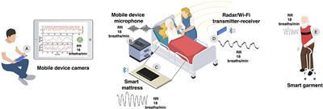
Introduction-Motivation
Why Healthcare?
Remote Patient Monitoring
Real time data analysis
Disease Management
Application Requirements
Functional
Remote monitoring, data collection and analytics, alert and notification etc.
Technical
Scalability, Data security and Privacy, Battery Efficiency and Reliability and so on.
Regulatory
Compliance, Fail-safe, audit and reporting etc.

Slide 5
Introduction-Contribution
Secured Patient Monitoring System
Ensuring security and privacy in data acquisition
Data Generation Simulation
Simulation tool in python to generate real life data
Cloud based Architecture
Leveraging Cloud server to share data between patient and doctor.

Slide 6
Introduction-Project Plan
Design an IoT based Health Care Application
Sensor Networks collecting patient data
Data Types
Blood pressure, heart rate and so on.
Cloud-based Architecture
Data would be synced to cloud server
Introducing alert system
Introducing Security and Privacy
Encrypted communication
Secured Access Control

Slide 7





Architecture-Components
Components
IoT device
Collects the patient health data
Smartphone
Gets data from the IoT device
Stores data in the cloud
Can be used to access data for the patient
Cloud Server
Stores the patients data
Doctors can view their individual patient data

Slide 8
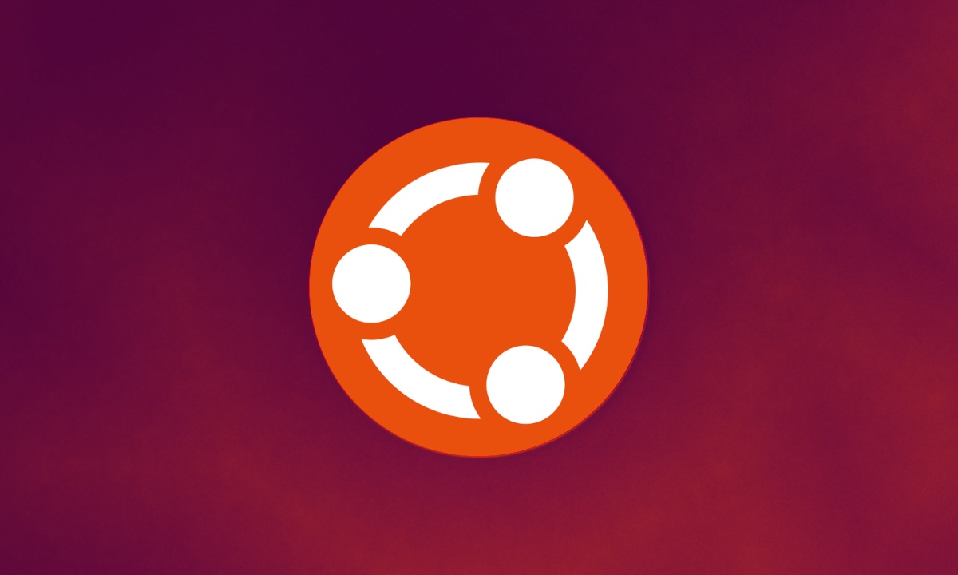
Implementation-VM Setup
VM Environment:
Operating System: Ubuntu
For reliability and robust security features.
Purpose:
Hosts the simulation code for generating healthcare data
Acts as an MQTT client to communicate with HiveMQ Cloud.
Configuration
Optimized for lightweight performance and real-time data processing.
VM Responsibilities:
Generate simulated health data.
Securely transmit data to HiveMQ Cloud.
Ensure consistent connectivity for real-time monitoring.

Slide 9
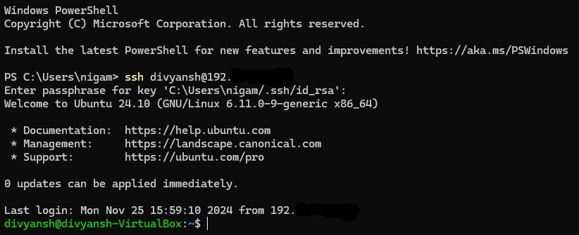
Implementation- Securing the VM
Key Security Measures Implemented:
SSH Access:
Remote access secured with Secure Shell (SSH) protocol.
Port 22 exclusively opened for SSH.
RSA Key-Based Authentication:
RSA key pairs ensure only authorized systems can access the VM
Public key stored securely on the VM
Private key remains confidential with the user.
Firewall Configuration
Limits inbound connections to essential ports (22 for SSH, 8883 for MQTT).

Slide 10
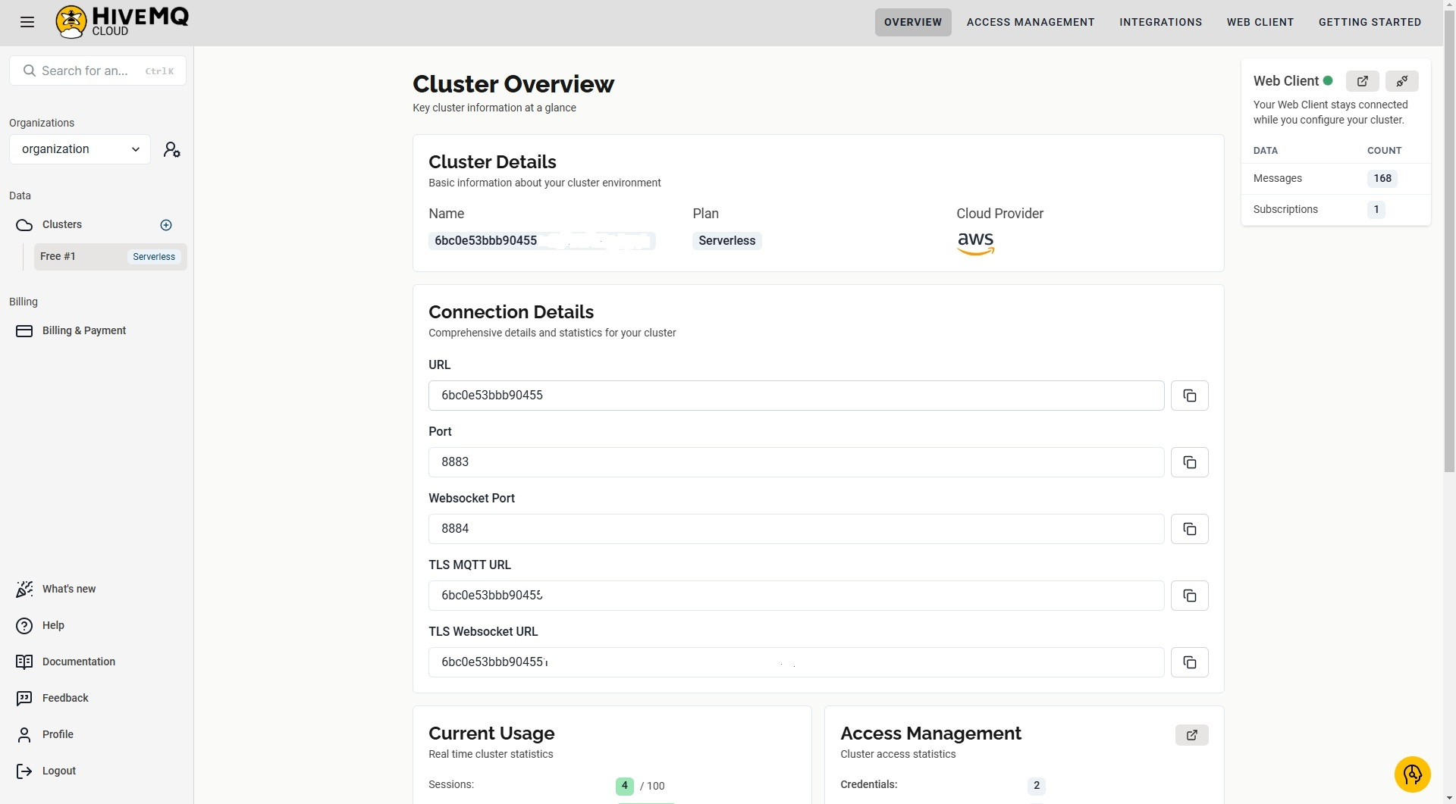
Implementation- HiveMQ Cloud
What is HiveMQ Cloud?
Managed MQTT broker
Designed for real-time data transmission.
Key role:
Acts as a secure intermediary between the VM and applications
Consuming the healthcare data, exclusively opened for SSH.
Features for VM Integration:
Secure Communication:
Supports TLS encryption on port 8883.
Topic-Based Messaging:
Enables organized communication
Scalability:
Handles multiple concurrent MQTT clients.
Global Availability:
Low latency for seamless real-time data flow.

Slide 11
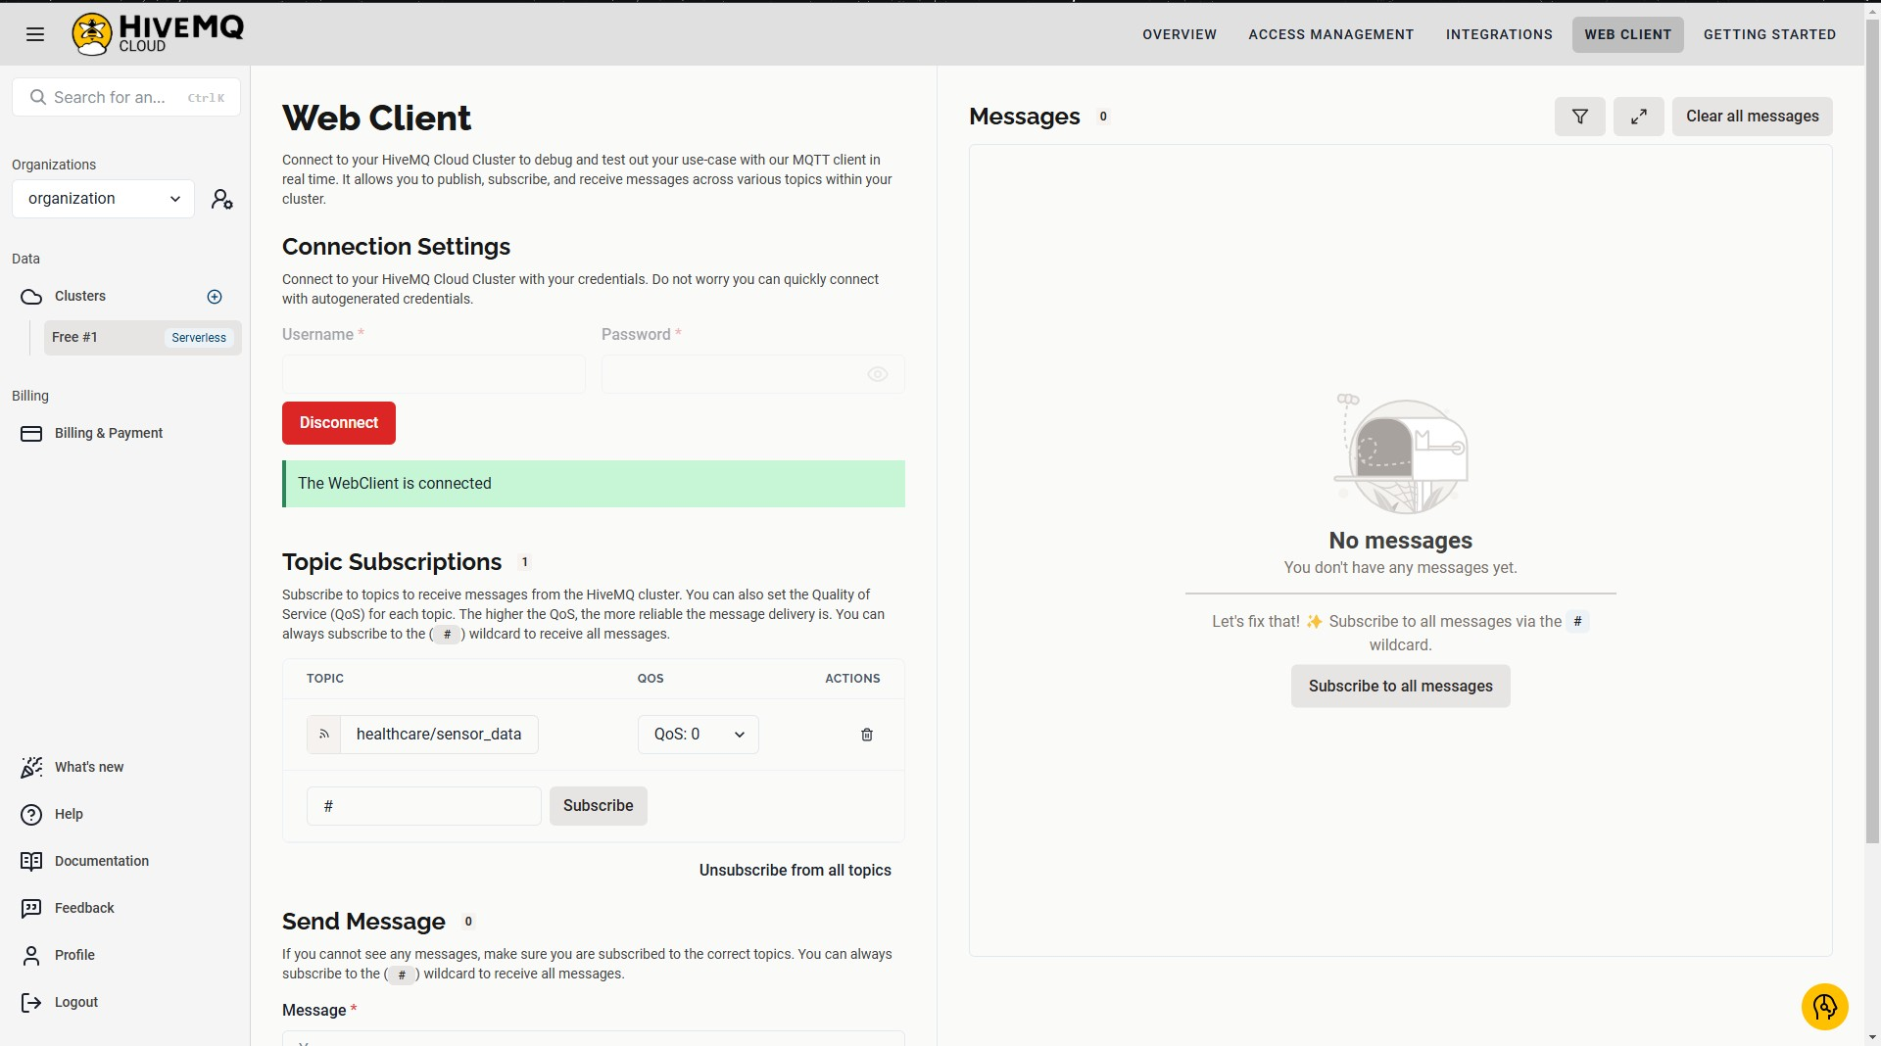
Implementation- HiveMQ Cloud
Security Integration:
Credentials-based authentication
username/password
End-to-end encryption
Ensures data integrity and confidentiality

Slide 12
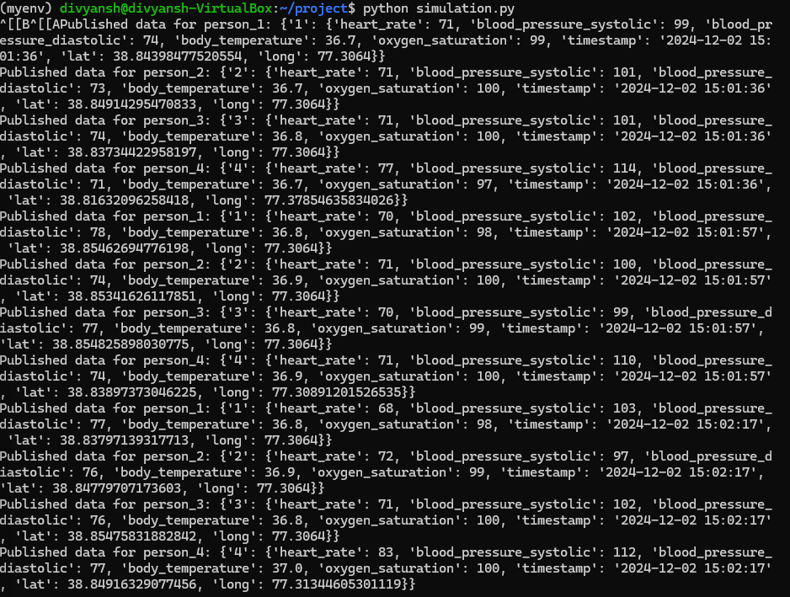
Implementation- Data Generation
Parameters Generated:
Heart Rate (bpm)
Indicates cardiac activity and detects irregularities.
Blood Pressure (mmHg)
Tracks systolic and diastolic health.
Body Temperature (°C)
Monitors thermal regulation.
Oxygen Saturation (%)
Measures blood oxygenation levels.
Latitude and Longitude
Track the location of the patient.

Slide 13
Implementation- Data Generation
Code Highlights:
Simulation Logic:
Class HealthyPerson, PersonWithHearthIssue and Alzheimer’s_patient
Simulate normal and abnormal health conditions
Data generated every 20 seconds for multiple individuals
JSON Formatting:
Structured for compatibility and parsing in healthcare applications.
Code Security:
Credentials Storage
Sensitive details centralized in mqtt_config.py.
TLS Integration
Secures MQTT connections during data publishing.

Slide 14
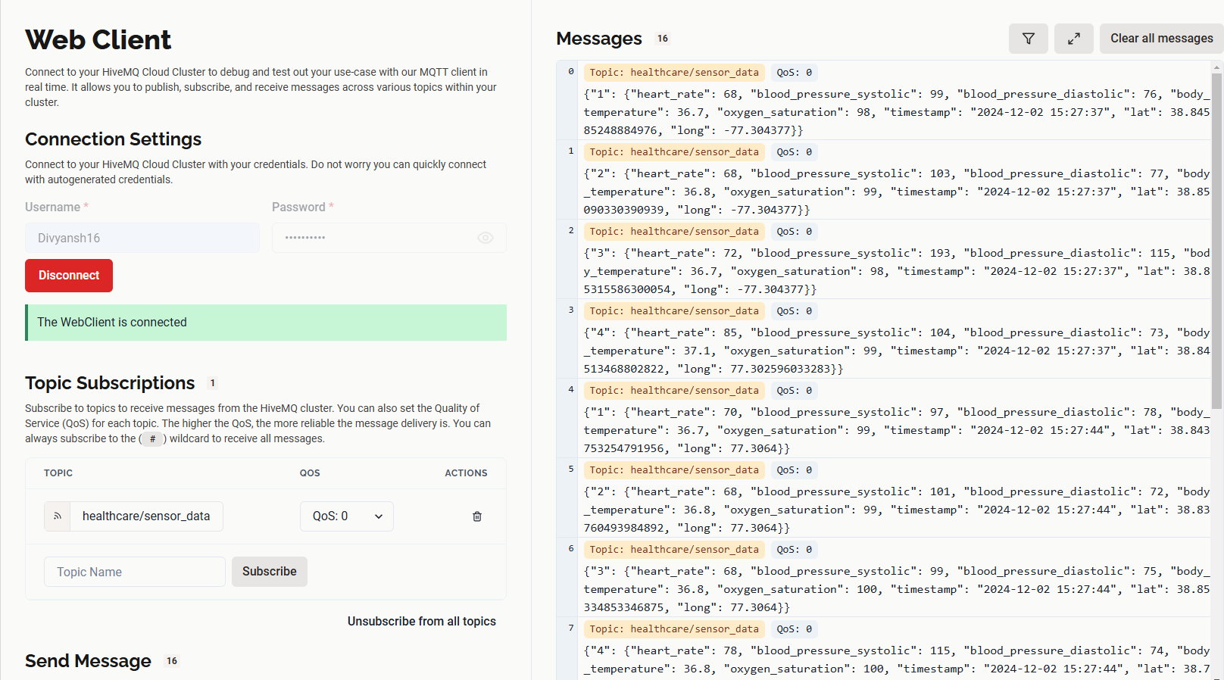
Implementation-Network Security
Transmission Workflow:
VM acts a MQTT Client
Data is published on specific topic
Cloud as intermediary
Data available for real-time analysis or visualization
Security Measures in Transmission:
TLS Encryption
Ensures data confidentiality during transmission and Uses HiveMQ Cloud's secure port (8883).​
Authentication
Username/password verified before the client connects.​
Persistent Connection
MQTT client maintains a live session for uninterrupted data flow.​
Topic Access Control
Messages are published to pre-defined, secure topics for better data management.​

Slide 15
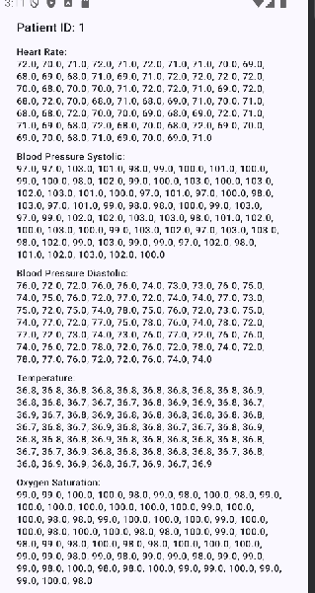
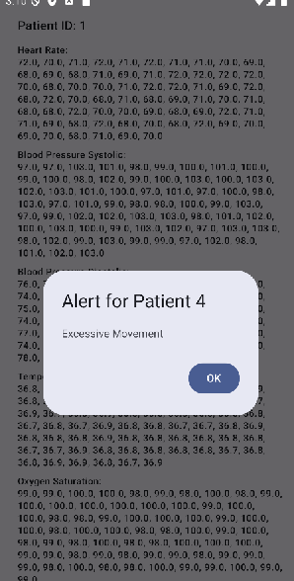
Implementation-Mobile Application
Doctor App
Monitor each assigned patients
Generate alerts if some abnormal condition occurs
Access Control
Only assigned patient’s data would be viewed

Slide 16
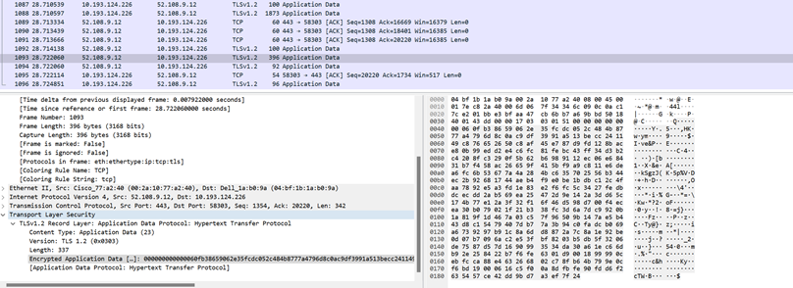
Implementation-TLS
Eavesdropping Security
TLS
Transport Layer security
Wireshark demo
Data is encrypted in both transmission and receiption.

Slide 17
Conclusion-Summary
Key Benefits
Security
Robust data protection measure
Scalability
Cloud integration supports scalability and seamless access
Efficiency
Automated alerts, data synchronization
Future Works
Introduction of physical devices
Using physical IoT devices to capture data
Experimentation in real environment
In real hospital settings or home environment
Data collected using smartwatch, sensor nodes and so on.

